Slide 1
Socket Programming
CS 5110
Spring 2016
Notes:
Today I am going to give a lecture about socket programming

Slide 2
Why Socket Programming
To build any network application
WWW
FTP
P2P
…
Notes:
The first question that one has to answer before he starts any topic is why socket programming or why this topic.
Now to answer very briefly and very concisely, I would like to say to build any network application. Socket programming is required.
A good example is of cause is the internet explorer or other web browsers. They basically fetch the web content from web server and display it. Another similar example is FTP clients fetch ftp contents from ftp server. The last but not the least, the p2p tools.
So in order to understand how this tools function and communicate, and how data are transferred across the internet between two entities, we need to understand socket programming.

Slide 3
Socket Programming
Goal: learn how to build client/server applications that communicate using sockets
Socket API
introduced in BSD4.1 UNIX, 1981
client/server paradigm
two types of transport services via socket API:
  reliable, byte stream-oriented
  unreliable datagram
socket
a host-local,
application-created,
OS-controlled interface (a “door”) into which
application process can both send and
receive messages to/from another application process
2: Application Layer
Notes:
Is introduced in 1981 by us Berkeley, but until 1989 the library is released for free from the licensing constraints of at&t

Slide 4
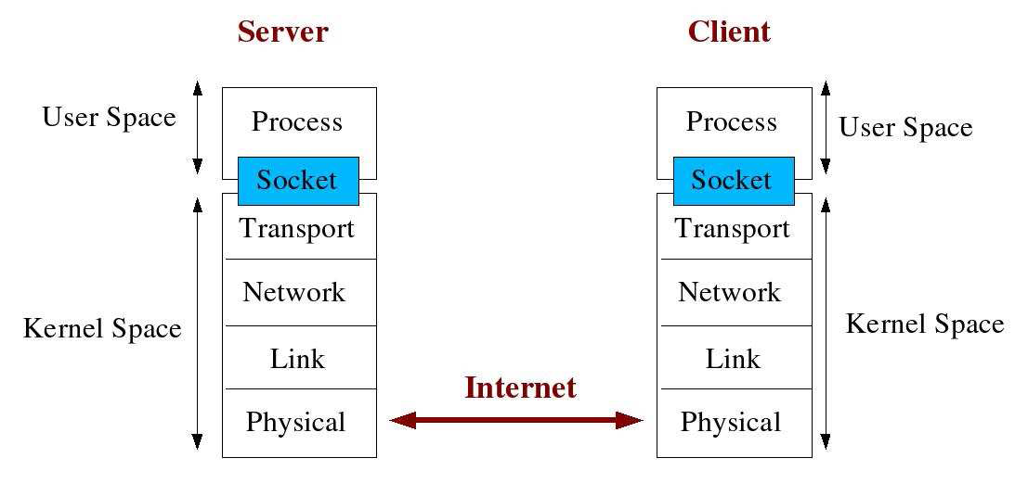
Architecture
socket
a host-local,
application-created,
OS-controlled interface (a “door”) into which
application process can both send and
receive messages to/from another application process

Slide 5
Types of Transport Services via Sockets
SOCK_STREAM
  Rely on TCP
  reliable delivery
  in-order guaranteed
  connection-oriented
SOCK_DGRAM
  Rely on UDP
  unreliable delivery
  no order guarantees
  no notion of “connection” – app indicates dest. for each packet
App
App
D1
3
2
3
2
D2
1
1
socket
Dest.
socket
D3

Slide 6
An Telephony Network Analogy
A telephone call over a “telephony network” works as follows:
Both parties have a telephone installed
A phone number is assigned to each telephone
Turn on ringer to listen for a caller
Caller lifts telephone and dials a number
Telephone rings and the receiver of the call picks it up
Both Parties talk and exchange data
After conversation is over they hang up the phone
Notes:
For better understanding, let’s see an analogy the telephony network

Slide 7
Dissecting the Analogy
A network application works as follows:
An endpoint (telephone) for communication is created on both ends
An address (phone no) is assigned to both ends to distinguish them from the rest of the network
One of the endpoints (caller) initiate a connection to the other
The other end (receiver) point waits for the communication to start
Once a connection has been made, data is exchanged (talk)
Once data has been exchanged the endpoints are closed (hang up)

Slide 8
In the World of Sockets……
Java
Socket() – Dial the number, used by clients
ServerSocket() – Assign a unique telephone number and wait for a caller
Accept() – Receive a call
DataInputStream(), getInputStream(), getOutputStream() -- Talk
Close() – Hang up
C
Socket() – Endpoint for communication
Bind() - Assign a unique telephone number
Listen() – Wait for a caller
Connect() - Dial a number
Accept() – Receive a call
Send(), Recv() – Talk
Close() – Hang up
Notes:
Now we have some basic understanding about socket and we are going to see the details about socket programming. I am going to give an example to show network communication with socket programming

Slide 9
Socket Programming using TCP -- Java
Client must contact server
server process must first be running
server must have created socket (door) that welcomes client’s contact
Client contacts server by:
creating client-local TCP socket
specifying IP address, port number of server process
When client creates socket: client TCP establishes connection to server TCP
When contacted by client, server TCP creates new socket for server process to communicate with client
  allows server to talk with multiple clients
  source port numbers used to distinguish clients
application viewpoint
TCP provides reliable, in-order
transfer of bytes (“pipe”)
between client and server
2: Application Layer

Slide 10
Client/server socket interaction: TCP
Server (running on hostid)
Client
create socket,
port=x, for
incoming request:
welcomeSocket =
ServerSocket()
TCP
connection setup
create socket,
connect to hostid, port=x
wait for incoming
connection request
connectionSocket =
welcomeSocket.accept()
clientSocket =
Socket()
send request using
clientSocket
read request from
connectionSocket
write reply to
connectionSocket
read reply from
clientSocket
close
connectionSocket
close
clientSocket
2: Application Layer

Slide 11
Socket programming with TCP
Example client-server app:
1) client reads line from standard input (inFromUser stream) , sends to server via socket (outToServer stream)
2) server reads line from socket
3) server converts line to uppercase, sends back to client
4) client reads, prints modified line from socket (inFromServer stream)
2: Application Layer

Slide 12
Example: Java client (TCP)
import java.io.*;
import java.net.*;
class TCPClient {
public static void main(String argv[]) throws Exception
{
String sentence;
String modifiedSentence;
BufferedReader inFromUser =
new BufferedReader(new InputStreamReader(System.in));
Socket clientSocket = new Socket("hostname", 6789);
DataOutputStream outToServer =
new DataOutputStream(clientSocket.getOutputStream());
Create
input stream
Create
client socket,
connect to server
Create
output stream
attached to socket
2: Application Layer

Slide 13
Example: Java client (TCP), cont.
Create
input stream
attached to socket
BufferedReader inFromServer =
new BufferedReader(new
InputStreamReader(clientSocket.getInputStream()));
sentence = inFromUser.readLine();
outToServer.writeBytes(sentence + '\n');
modifiedSentence = inFromServer.readLine();
System.out.println("FROM SERVER: " + modifiedSentence);
clientSocket.close();
}
}
Send line
to server
Read line
from server
2: Application Layer

Slide 14
Example: Java server (TCP)
import java.io.*;
import java.net.*;
class TCPServer {
public static void main(String argv[]) throws Exception
{
String clientSentence;
String capitalizedSentence;
ServerSocket welcomeSocket = new ServerSocket(6789);
while(true) {
Socket connectionSocket = welcomeSocket.accept();
BufferedReader inFromClient =
new BufferedReader(new
InputStreamReader(connectionSocket.getInputStream()));
Create
welcoming socket
at port 6789
Wait, on welcoming
socket for contact
by client
Create input
stream, attached
to socket
2: Application Layer

Slide 15
Example: Java server (TCP), cont
Create output
stream, attached
to socket
DataOutputStream outToClient =
new DataOutputStream(connectionSocket.getOutputStream());
clientSentence = inFromClient.readLine();
capitalizedSentence = clientSentence.toUpperCase() + '\n';
outToClient.writeBytes(capitalizedSentence);
}
}
}
Read in line
from socket
Write out line
to socket
End of while loop,
loop back and wait for
another client connection
2: Application Layer

Slide 16
Socket programming with UDP
UDP: no “connection” between client and server
no handshaking
sender explicitly attaches IP address and port of destination to each packet
server must extract IP address, port of sender from received packet
UDP: transmitted data may be received out of order, or lost
application viewpoint
UDP provides unreliable transfer
of groups of bytes (“datagrams”)
between client and server
2: Application Layer

Slide 17
Client/server socket interaction: UDP
Server (running on hostid)
Client
create socket,
port=x, for
incoming request:
create socket,
clientSocket =
DatagramSocket()
serverSocket =
DatagramSocket()
Create, address (hostid, port=x,
send datagram request
using clientSocket
read request from
serverSocket
write reply to
serverSocket
specifying client
host address,
port number
read reply from
clientSocket
close
clientSocket
2: Application Layer

Slide 18
Example: Java client (UDP)
import java.io.*;
import java.net.*;
class UDPClient {
public static void main(String args[]) throws Exception
{
BufferedReader inFromUser =
new BufferedReader(new InputStreamReader(System.in));
DatagramSocket clientSocket = new DatagramSocket();
InetAddress IPAddress = InetAddress.getByName("hostname");
byte[] sendData = new byte[1024];
byte[] receiveData = new byte[1024];
String sentence = inFromUser.readLine();
sendData = sentence.getBytes();
Create
input stream
Create
client socket
Translate
hostname to IP
address using DNS
2: Application Layer

Slide 19
Example: Java client (UDP), cont.
Create datagram with data-to-send,
length, IP addr, port
DatagramPacket sendPacket =
new DatagramPacket(sendData, sendData.length, IPAddress, 9876);
clientSocket.send(sendPacket);
DatagramPacket receivePacket =
new DatagramPacket(receiveData, receiveData.length);
clientSocket.receive(receivePacket);
String modifiedSentence =
new String(receivePacket.getData());
System.out.println("FROM SERVER:" + modifiedSentence);
clientSocket.close();
}
}
Send datagram
to server
Read datagram
from server
2: Application Layer

Slide 20
Example: Java server (UDP)
import java.io.*;
import java.net.*;
class UDPServer {
public static void main(String args[]) throws Exception
{
DatagramSocket serverSocket = new DatagramSocket(9876);
byte[] receiveData = new byte[1024];
byte[] sendData = new byte[1024];
while(true)
{
DatagramPacket receivePacket =
new DatagramPacket(receiveData, receiveData.length);
serverSocket.receive(receivePacket);
Create
datagram socket
at port 9876
Create space for
received datagram
Receive
datagram
2: Application Layer

Slide 21
Example: Java server (UDP), cont
String sentence = new String(receivePacket.getData());
InetAddress IPAddress = receivePacket.getAddress();
int port = receivePacket.getPort();
String capitalizedSentence = sentence.toUpperCase();
sendData = capitalizedSentence.getBytes();
DatagramPacket sendPacket =
new DatagramPacket(sendData, sendData.length, IPAddress,
port);
serverSocket.send(sendPacket);
}
}
}
Get IP addr
port #, of
sender
Create datagram
to send to client
Write out
datagram
to socket
End of while loop,
loop back and wait for
another datagram
2: Application Layer

Slide 22
Summary
Socket is an interface through which application processes communicate with each other
Server and client paradigm
Two types of socket communication:
  Connect-oriented socket: SOCK_STREAM
  Connectless socket: SOCK_DGRAM

Slide 23
Other
Access tux machine
SSH secure shell client or Putty
Connect to remote host:
  Host name: tux.sce.umkc.edu
  User name: your UMKC SSO ID
  Port number: 22
  Password: your UMKC SSO password

Slide 24
Q/A
Thank you

